Slide 1
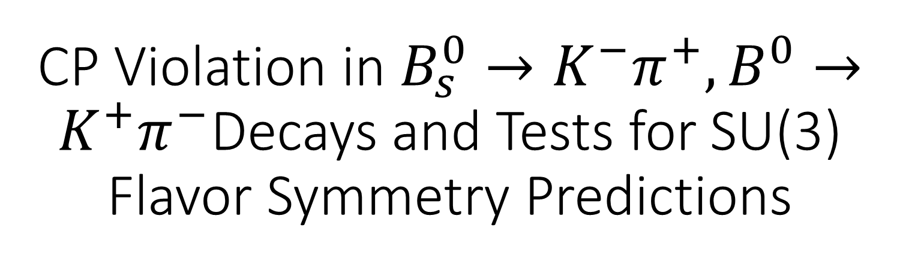
CP Violation in $B_{s}^{0}→K^{−}π^{+}, B^{0}→K^{+}π^{−}$Decays and Tests for SU(3) Flavor Symmetry Predictions
Xiao-Gang He , Siao-Fong Li, and Hsiu-Hsien Lin
NTU
JHEP08(2013)065

Slide 2

Outline
Motivation
Introduction
$B_{s}^{0}→K^{−}π^{+}, B^{0}→K^{+}π^{−}$
Breaking effect
Other Decays
Summary

Slide 3
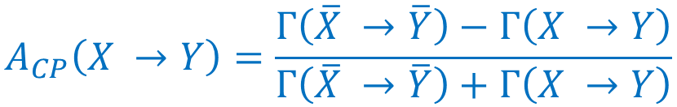
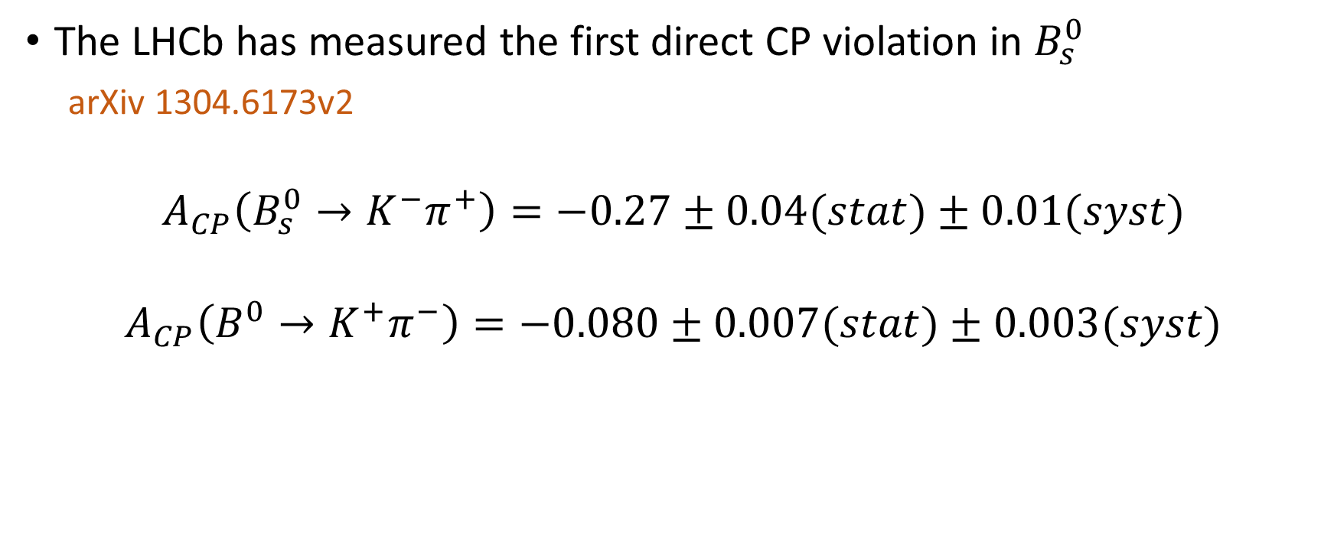
Motivation
The LHCb has measured the first direct CP violation in $B_{s}^{0}$
arXiv 1304.6173v2
$$A_{CP}\left(B_{s}^{0}→K^{−}π^{+}\right)=−0.27±0.04(stat)±0.01(syst)$$
$$A_{CP}\left(B^{0}→K^{+}π^{−}\right)=−0.080±0.007(stat)±0.003(syst)$$
$$A_{CP}\left(X →Y\right)=\frac{Γ\left(\overline{X} →\overline{Y}\right)−Γ\left(X →Y\right)}{Γ\left(\overline{X} →\overline{Y}\right)+Γ\left(X →Y\right)}$$

Slide 4
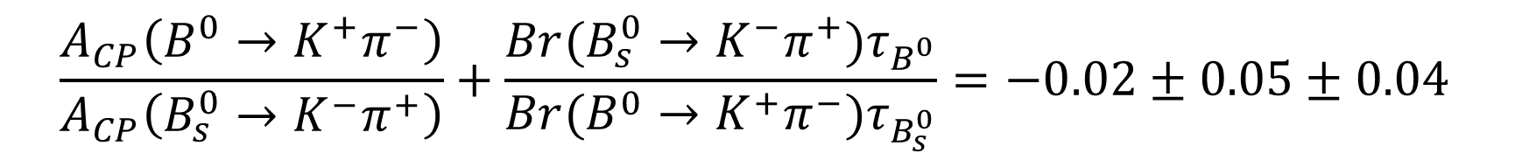


Motivation
$$A_{CP}$$
Relation between
$$\frac{A_{CP}\left(B^{0}→K^{+}π^{−}\right)}{A_{CP}\left(B_{s}^{0}→K^{−}π^{+}\right)}+\frac{Br(B_{s}^{0}→K^{−}π^{+})τ_{B^{0}}}{Br(B^{0}→K^{+}π^{−})τ_{B_{s}^{0}}}=−0.02±0.05±0.04$$
$$=0 CKM, SU(3)$$
$$Δ\left(B^{0}→K^{+}π^{−}\right)=−Δ(B_{s}^{0}→K^{−}π^{+})$$
$$Δ\left(X →Y\right)=Γ\left(\overline{X} →\overline{Y}\right)−Γ\left(X →Y\right)$$

Slide 5
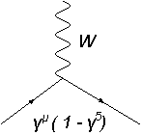
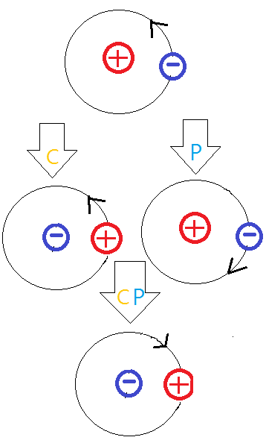
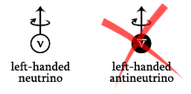
Introduction-
CP Violation and KM mechanism
P parity and C parity

Slide 6


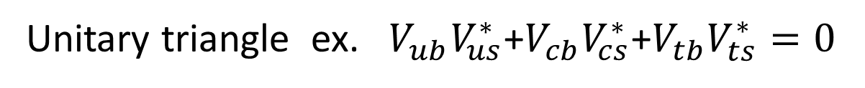
Introduction-
CP Violation and KM mechanism
KM Matrix
Important properties
Unitary triangle ex. $V_{ub}V_{us}^{∗}$+$V_{cb}V_{cs}^{∗}$+$V_{tb}V_{ts}^{∗}=0$
Jarlskog Invariant ex. $−Im\left(V_{ub}V_{ud}^{∗}{V_{tb}^{∗}V}_{td}\right)=Im\left(V_{ub}V_{us}^{∗}V_{tb}^{∗}V_{ts}\right)=J$
$$J=s_{1}^{2}s_{2}s_{3}c_{1}c_{2}c_{3}sinδ$$

Slide 7
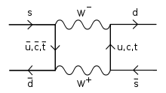



Introduction-
Three types of CP Violation
Indirect CP violation
CP Violation in mixing
CP Violation in interference of decays with and without mixing
Direct CP violation
$$P\left(B→\overline{B}\right)≠P(\overline{B}→B)$$
$$P(B(t)→f_{CP})≠P(\overline{B}(t)→f_{CP})$$
$$P\left(B→f\right)≠P(\overline{B}→\overline{f})$$
! We do.

Slide 8
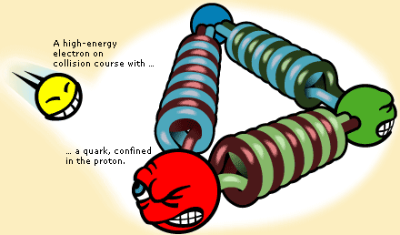
Introduction-
Decay amplitude
In hadrons……
Operator Product Expansion(Wilson and Zimermann,1972)

Slide 9
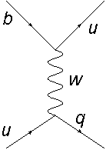
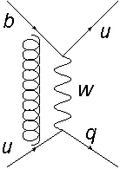
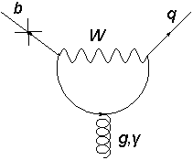
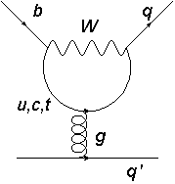
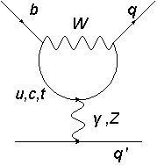
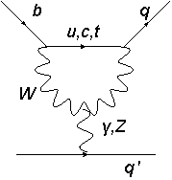








Introduction-
Decay amplitude
$$O_{1}={({\overline{q}}_{i}u_{j})}_{V−A}{({\overline{u}}_{i}b_{j})}_{V−A}$$
$$O_{2}={(\overline{q}u)}_{V−A}{(\overline{u}b)}_{V−A}$$
$$O_{3,5}={(\overline{q}b)}_{V−A}Σ_{q′}{({\overline{q}}^{′}q′)}_{V∓A}$$
$$O_{11}=\frac{g_{s}}{16π^{2}}\overline{q}σ_{μυ}G^{μν}\left(1+γ^{5}\right)b$$
$$O_{4,6}={{({\overline{q}}_{i}b_{j})}_{V−A}Σ}_{q′}{({\overline{q′}}_{j}{q′}_{i})}_{V∓A}$$
$$O_{12}=\frac{Q_{b}e}{16π^{2}}\overline{q}σ_{μυ}F^{μν}\left(1+γ^{5}\right)b$$
$$O_{7,9}=\frac{3}{2}{(\overline{q}b)}_{V−A}Σ_{q′}{e_{q′}({\overline{q}}^{′}q′)}_{V∓A}$$
$$O_{8,10}=\frac{3}{2}{{({\overline{q}}_{i}b_{j})}_{V−A}Σ}_{q′}e_{q′}{({\overline{q′}}_{j}{q′}_{i})}_{V∓A}$$
Buras et al., Phys. Mod. Vol.68 No.4

Slide 10
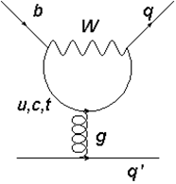
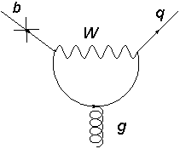
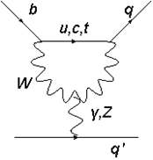
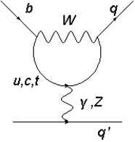
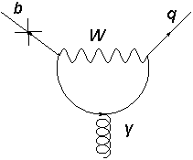
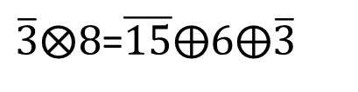
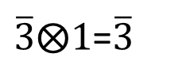

Introduction-
SU(3) Flavor Symmetry
SU(3) flavor symmetry
Lagrangian isn’t affected by flavor transformation.
$$m_{b}≅4.2 GeV>Λ_{QcD}≅1GeV≫m_{u,d,s}$$
$$\overline{3}⨂3⨂\overline{3}=\overline{15}⨁6⨁\overline{3}⨁\overline{3}$$
$\overline{3}⨂8$=$\overline{15}⨁6⨁\overline{3}$
$\overline{3}⨂1$=$\overline{3}$

Slide 11
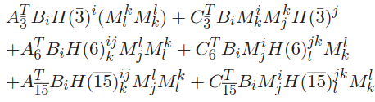

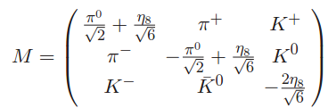
Introduction-
SU(3) Flavor Symmetry
Effective Hamilton

Slide 12
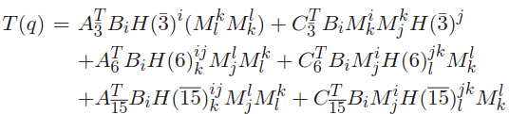
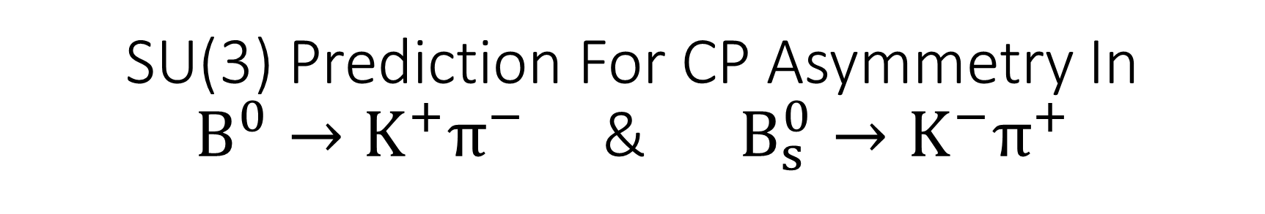
SU(3) Prediction For CP Asymmetry In
$B^{0}→K^{+}π^{−}$ & $B_{s}^{0}→K^{−}π^{+}$
q=d
q=s
M Savage et al. , Phys. Rev. D 39, 3346

Slide 13
SU(3) Prediction For CP Asymmetry In
$B^{0}→K^{+}π^{−}$ & $B_{s}^{0}→K^{−}π^{+}$

Slide 14
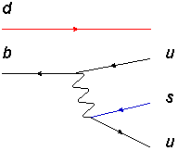
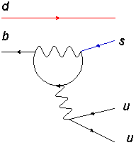
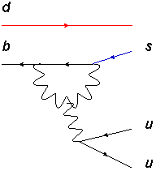
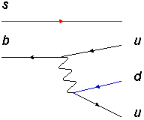
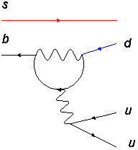
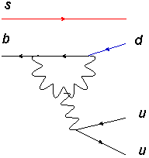



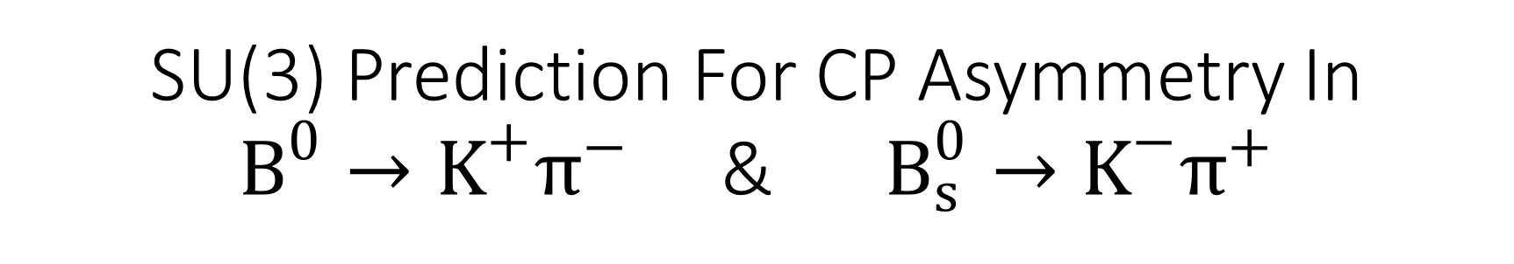


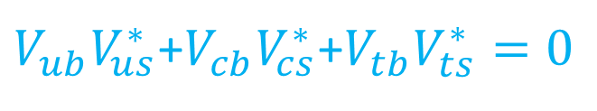

SU(3) Prediction For CP Asymmetry In
$B^{0}→K^{+}π^{−}$ & $B_{s}^{0}→K^{−}π^{+}$
$$d\overline{b}$$
u$\overline{s}$
$$d\overline{u}$$
$$s\overline{b}$$
$$s\overline{u}$$
u$\overline{d}$
T
P
P
P
$V_{ub}V_{us}^{∗}$+$V_{cb}V_{cs}^{∗}$+$V_{tb}V_{ts}^{∗}=0$

Slide 15
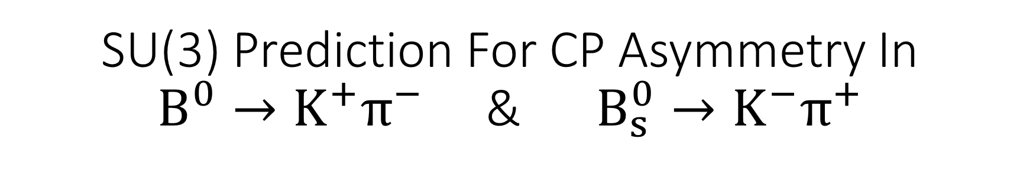
SU(3) Prediction For CP Asymmetry In
$B^{0}→K^{+}π^{−}$ & $B_{s}^{0}→K^{−}π^{+}$
$$d\overline{b}$$
u$\overline{s}$
$$d\overline{u}$$
$$s\overline{b}$$
$$s\overline{u}$$
u$\overline{d}$
SU(3) Symmetry
$$m_{b}≅4.2 GeV>Λ_{QcD}≅1GeV≫m_{u,d,s}$$
$$A\left(B^{0}→K^{+}π^{−}\right)={V_{ub}^{∗}V}_{us}T+{V_{tb}^{∗}V}_{ts}P$$
$$A\left(B_{s}^{0}→K^{−}π^{+}\right)={V_{ub}^{∗}V}_{ud}T+{V_{tb}^{∗}V}_{td}P$$
$$A\left({\overline{B}}^{0}→K^{−}π^{+}\right)=V_{ub}V_{us}^{∗}T+V_{tb}V_{ts}^{∗}P$$
$$A\left({\overline{B}}^{0}→K^{−}π^{+}\right)=V_{ub}V_{ud}^{∗}T+V_{tb}V_{td}^{∗}P$$

Slide 16

SU(3) Prediction For CP Asymmetry In
$B^{0}→K^{+}π^{−}$ & $B_{s}^{0}→K^{−}π^{+}$
$$A\left(B^{0}→K^{+}π^{−}\right)={V_{ub}^{∗}V}_{us}T+{V_{tb}^{∗}V}_{ts}P$$
$$A\left(B_{s}^{0}→K^{−}π^{+}\right)={V_{ub}^{∗}V}_{ud}T+{V_{tb}^{∗}V}_{td}P$$
$$A\left({\overline{B}}^{0}→K^{−}π^{+}\right)=V_{ub}V_{us}^{∗}T+V_{tb}V_{ts}^{∗}P$$
$$A\left({\overline{B}}^{0}→K^{−}π^{+}\right)=V_{ub}V_{ud}^{∗}T+V_{tb}V_{td}^{∗}P$$
$$−Im\left(V_{ub}V_{ud}^{∗}{V_{tb}^{∗}V}_{td}\right)=Im\left(V_{ub}V_{us}^{∗}V_{tb}^{∗}V_{ts}\right)$$
$$Δ\left(B^{0}→K^{+}π^{−}\right)=−Δ(B_{s}^{0}→K^{−}π^{+})$$

Slide 17
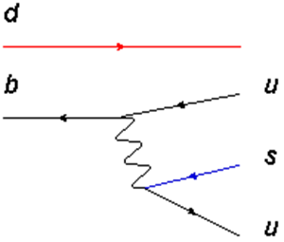
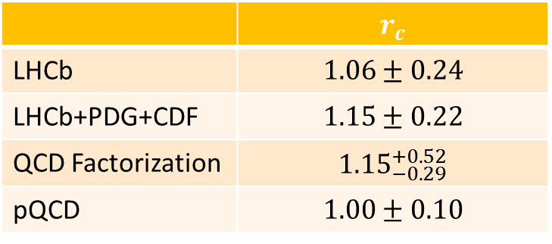
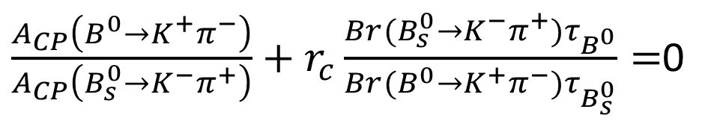
Breaking Effects
Deviation from experiment and theory
We can’t conclude that large SU(3) breaking in the relation.
$\frac{A_{CP}\left(B^{0}→K^{+}π^{−}\right)}{A_{CP}\left(B_{s}^{0}→K^{−}π^{+}\right)}+r_{c}\frac{Br(B_{s}^{0}→K^{−}π^{+})τ_{B^{0}}}{Br(B^{0}→K^{+}π^{−})τ_{B_{s}^{0}}}=$0
 | $$r_{c}$$
LHCb | $$1.06±0.24$$
LHCb+PDG+CDF | $$1.15±0.22$$
QCD Factorization | $${1.15}_{−0.29}^{+0.52}$$
pQCD | $$1.00±0.10$$
Experiment
Theory

Slide 18

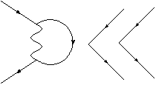

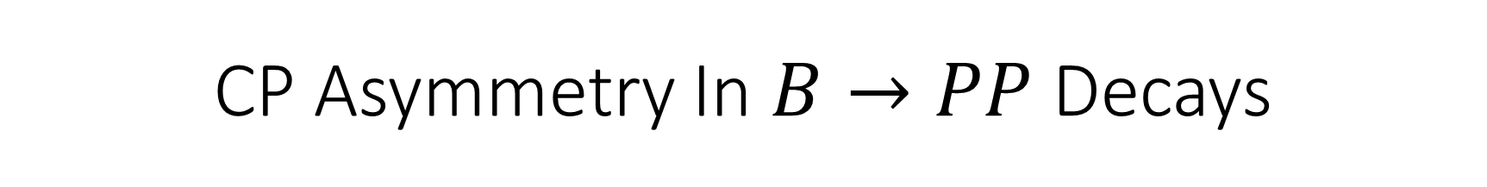
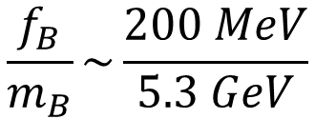
CP Asymmetry In $B→PP$ Decays
$$\frac{f_{B}}{m_{B}}\sim \frac{200 MeV}{5.3 GeV}$$

Slide 19
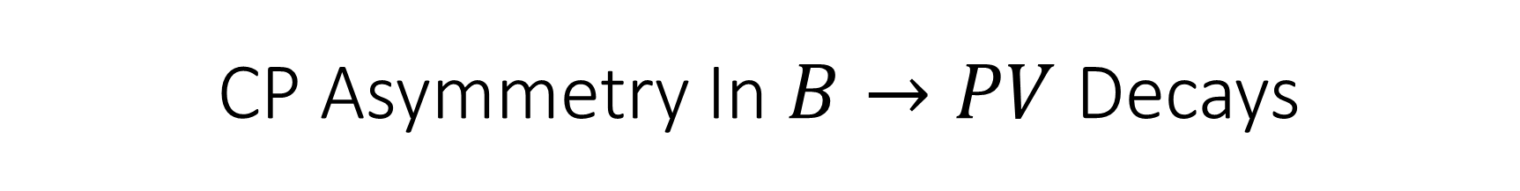
CP Asymmetry In $B→PV$ Decays

Slide 20








CP Asymmetry In $B→PP$ Decays
Sign | Size
O | X
X | X
O | O
O | X
arXiv:1308.1277v1
X
X
$$−0.21±0.14±0.01$$
$$0.013±0.0027$$
$$−0.022±0.025±0.010$$
$$0.344±0.424$$
arXiv:1308.1428v1
O
X
$$0.38±0.15±0.02$$
$$−0.079±0.032$$
$$−0.14±0.11±0.02$$
$$0.677±0.544$$

Slide 21
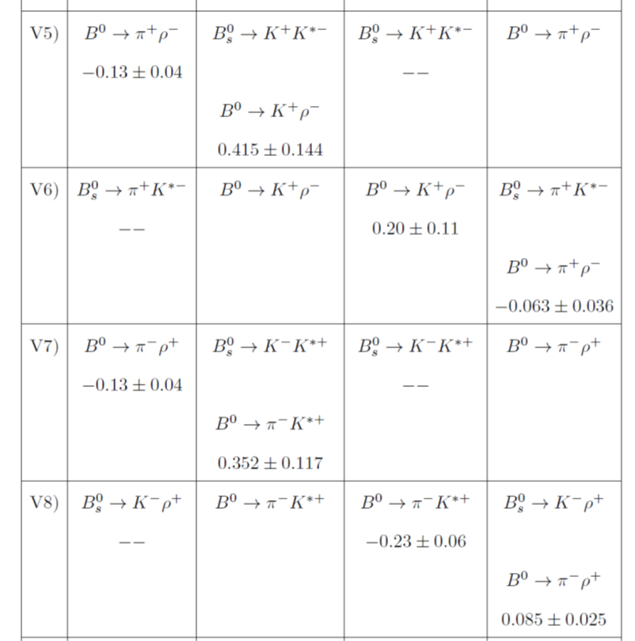
CP Asymmetry In $B→PV$ Decays
Sign | Size
O | X
X | X
Generally different

Slide 22
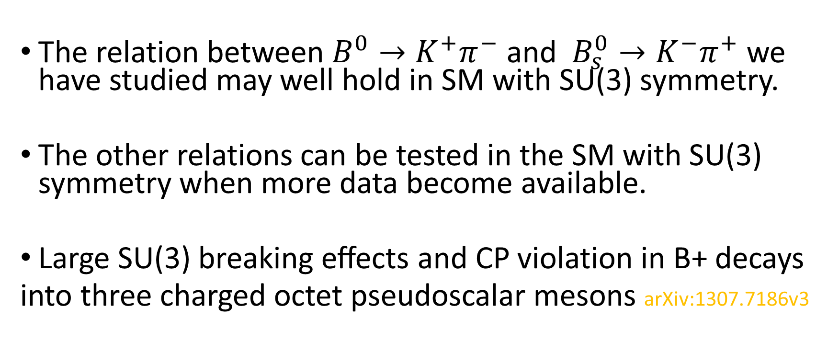
Summary
The relation between $B^{0}→K^{+}π^{−}$ and $B_{s}^{0}→K^{−}π^{+}$ we have studied may well hold in SM with SU(3) symmetry.
The other relations can be tested in the SM with SU(3) symmetry when more data become available.
Large SU(3) breaking eﬀects and CP violation in B+ decays
into three charged octet pseudoscalar mesons arXiv:1307.7186v3

Slide 23
Thank for your attention

